Slide 1

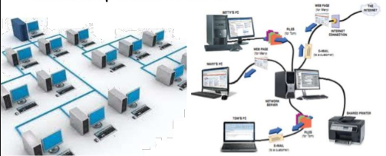
What is Computer networking?

